Slide 1
Machine Learning for data science and business intelligence – 8IAR403
By Kévin Bouchard Ph.D.
Professor in artificial intelligence & machine learning
Laboratoire d'Intelligence Ambiante pour la reconnaissance d'activités (LIARA)
Université du Québec à Chicoutimi
www.Kevin-Bouchard.ca

Slide 2

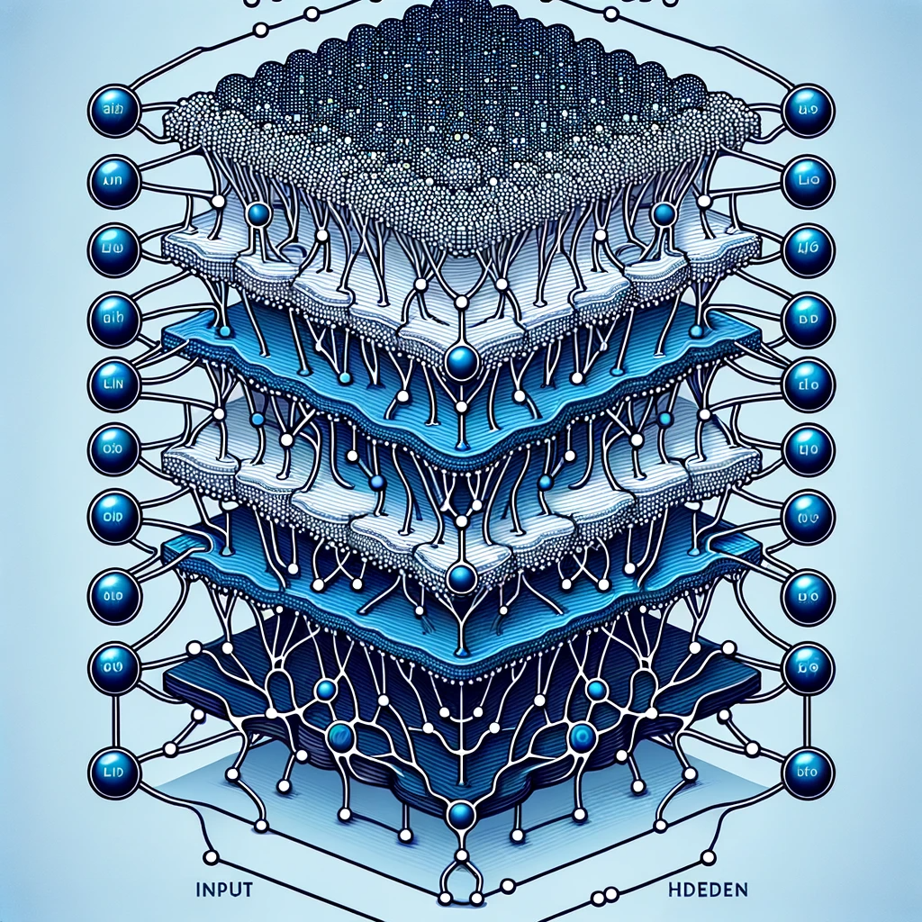
Summary of lesson #13
You will learn about:
How to use the key concepts of ensemble learning to build much more powerful and more generalizable models
How to transform boosting using the concepts of gradient and optimization
How to exploit stacking to build multilayers neural networks

Slide 3
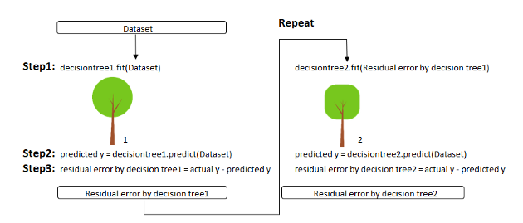
Gradient Boosting
In gradient boosting algorithms, we do not proceed in the same way to detect the weaknesses of weak classifiers.
A mix between our Gradient Descent and Boosting methods

Slide 4
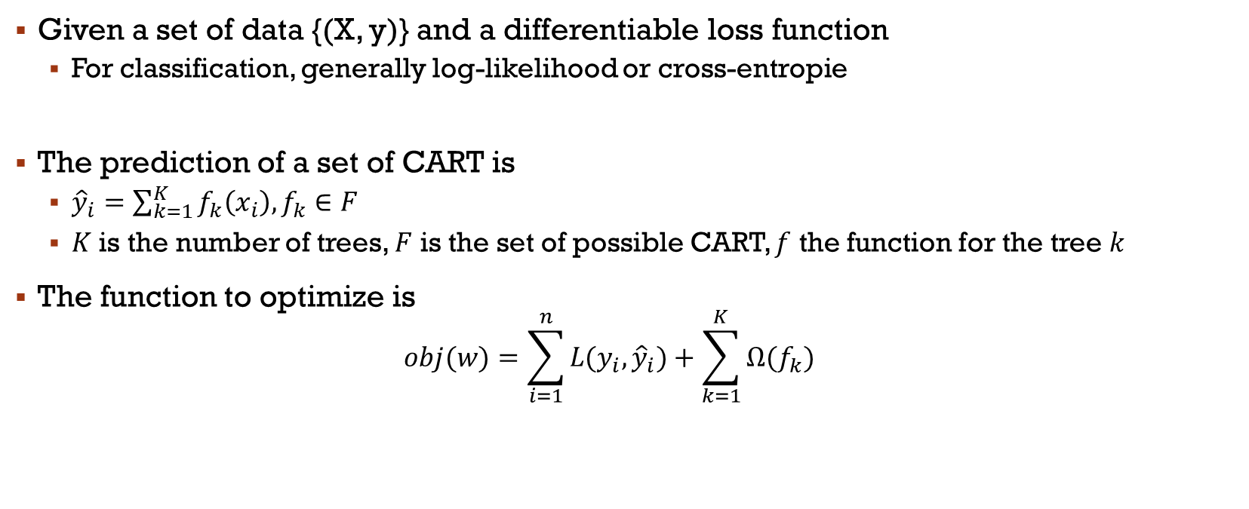
Generic Algorithm
Given a set of data {(X, y)} and a differentiable loss function
For classification, generally log-likelihood or cross-entropie
The prediction of a set of CART is
${\hat{y}}_{i}=\sum_{k=1}^{K}{f_{k}\left(x_{i}\right),f_{k}∈F}$
$K$ is the number of trees, $F$ is the set of possible CART, $f$ the function for the tree $k$
The function to optimize is
$$obj(w)=\sum_{i=1}^{n}{L(y_{i}, {\hat{y}}_{i})}+\sum_{k=1}^{K}{Ω(f_{k})}$$
Regularization
Cost function

Slide 5
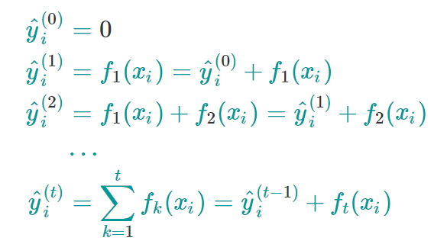
Generic Algorithm
The main difference with other tree ensembles is the way we train!!!
We add one tree at a time, according to the steps t
The prediction by step→

Slide 6
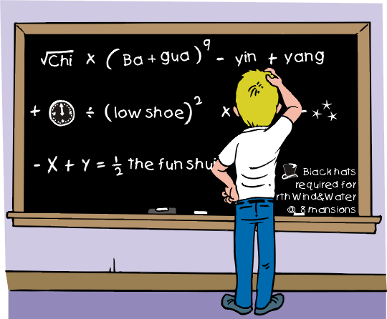
In short
Okay, this is a bit complicated...
What you need to remember:
Even though Gradient Boosting was discovered later, Adaboost is actually a specific case of Gradient Boosting!
Gradient Boosting uses optimization to iteratively improve the 'weak learners
from sklearn.model_selection import cross_val_score from sklearn.datasets import load_iris from sklearn.ensemble import GradientBoostingClassifier X, y = load_iris(return_X_y=True) clf = GradientBoostingClassifier(n_estimators=100) scores = cross_val_score(clf, X, y, cv=5) print(scores.mean())

Slide 7
Main Variations
Histogram-Based Gradient Boosting (in Scikit-Learn)
Does not use data sets at nodes for splitting attributes
Uses an ordered histogram of values
Based on LightGBM
XGBoost (open-source implementation)
Roughly, a hyper-efficient version of GBDT
GBDT with regularization and lots of parallelization!!!
CatBoost
Categorical variables
Simple to use

Slide 8
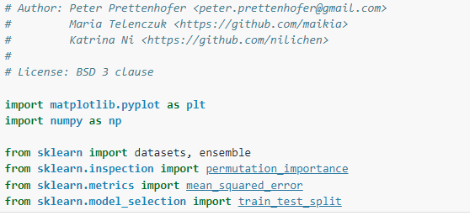
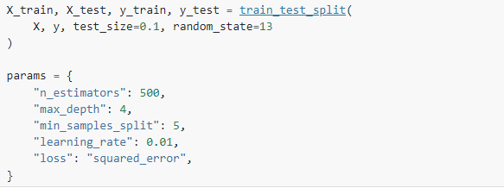
Example
We said before, most algorithm can be used for both regression and classification
Let us look at a code example from Scikit-Learn documentation
Notes:
https://scikit-learn.org/stable/auto_examples/ensemble/plot_gradient_boosting_regression.html#sphx-glr-auto-examples-ensemble-plot-gradient-boosting-regression-py

Slide 9
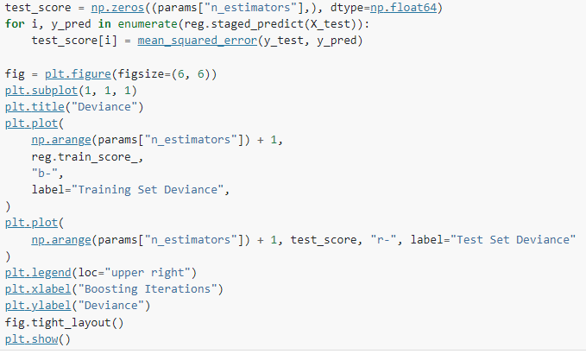
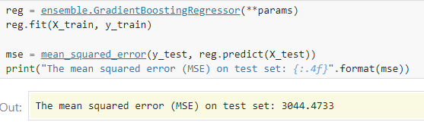
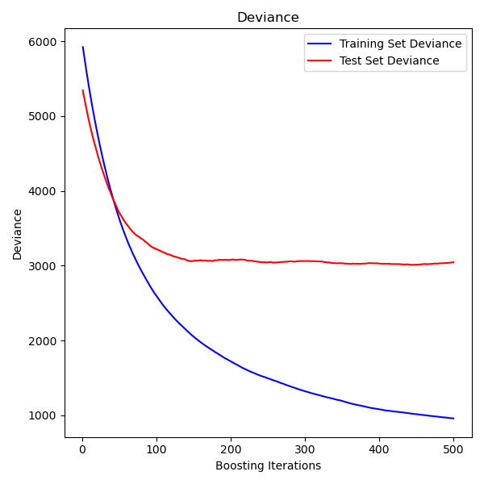
Example

Slide 10
Another example
Scikit-Learn also has an example comparing Random Forest to Histogram Gradient Boosting
Even though Random Forest is often simpler to use and more robust to noise, in their example, we see that overall HGBT is outperforming
https://scikit-learn.org/stable/auto_examples/ensemble/plot_forest_hist_grad_boosting_comparison.html#sphx-glr-auto-examples-ensemble-plot-forest-hist-grad-boosting-comparison-py

Slide 11
Conclusion on ensemble Learning
Strong points
Weak points
Improved Accuracy: By combining multiple models, ensemble methods can often achieve higher accuracy than individual models
Reduced Variance: Ensemble methods can reduce the variance part of the error, which can lead to overfitting in single models
Reduced Bias: Some ensemble methods, like boosting, can reduce the bias of the model
Increased Computational Complexity: Since multiple models are being trained, the computational cost can be significantly higher than training a single model
Model Interpretability: Ensemble models, especially those with many layers of models (like in stacking) or many components (like in Random Forests), can be very difficult to interpret

Slide 12
Conclusion on ensemble Learning
Strong points
Weak points
Robustness to Noise and Outliers: Since they aggregate the predictions of multiple models, the impact of anomalous data points is often reduced, leading to more stable and reliable predictions
Handling Non-Linearities and Complex Interactions: Ensemble methods, especially those that combine models of different types, are often effective at capturing complex nonlinear relationships and interactions between features
Data Imbalance Sensitivity: Ensemble methods, especially boosting algorithms, can be sensitive to imbalanced datasets. They might end up focusing too much on the minority class, leading to poor generalization on the majority class.
Difficulty in Updating Models: In some applications, models need to be frequently updated with new data (like in streaming data scenarios) which is difficult with ensemble

Slide 13



Stacking neurons?
Using what we learnt from ensemble, we can assemble multiple artificial neurons to augment the expressive power of the model
This leads to the emergence of deep learning
It has been the most popular trend in machine learning in the past 14 years
Deep learning is a bit more than simply stacking a few neurons
It is a set of algorithms developed for the training of artificial neural networks with multiple layers
Interest in NNs was revived in 1986 with the discovery of the backpropagation algorithm, which allows for easier training of multilayer networks
For now, let’s just have a look at the basics

Slide 14
Multiples couches
Our neural networks are single-layer, even though there is an input layer and an output layer because of the unique link that connects them
But, similarly to what we saw with stacking, we could easily stack multiple individual neurons to take advantage of the power of ensemble learning
We can add a hidden layer of neurons to form a multi-layer feed-forward neural network
We simply call them artificial neural network ANN from now on, and we’ll describe a few types
Unlike a single-layer neurons, a multilayer ANN can possibly separate data that is not linearly separable
Notes:
Exactement comme le modèle qu’on a vu de stacking, où la couche est toujours le même classifier

Slide 15
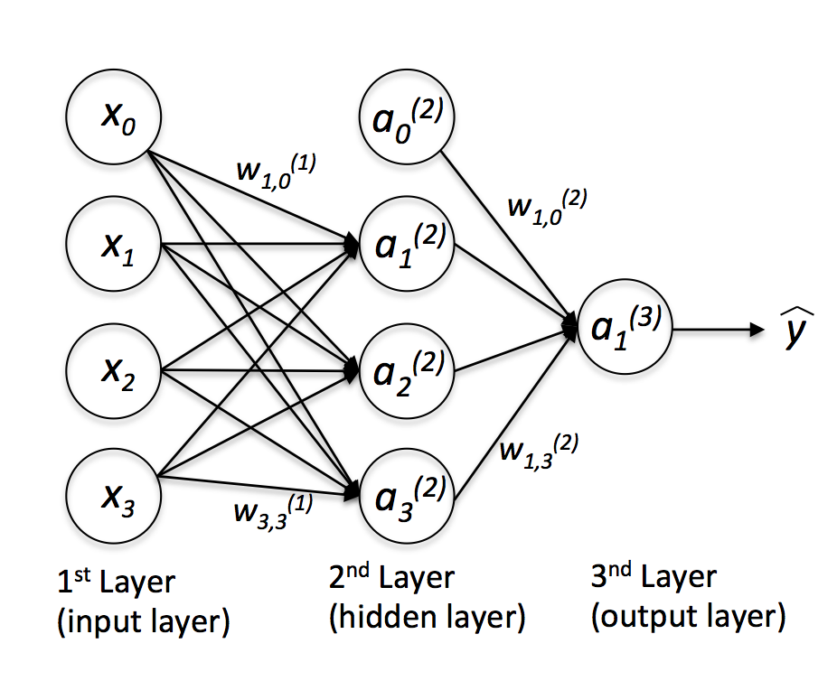
Multilayer Perceptron
A Multilayer Perceptron (MLP) is a class of feedforward artificial neural network (ANN)
It consists of at least three layers of nodes: an input layer, a hidden layer, and an output layer
The neurons of the hidden layer are fully connected to the input layer and the output layer
If more than one hidden layer is needed, then deep learning techniques are necessary

Slide 16
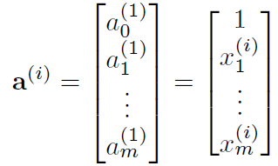
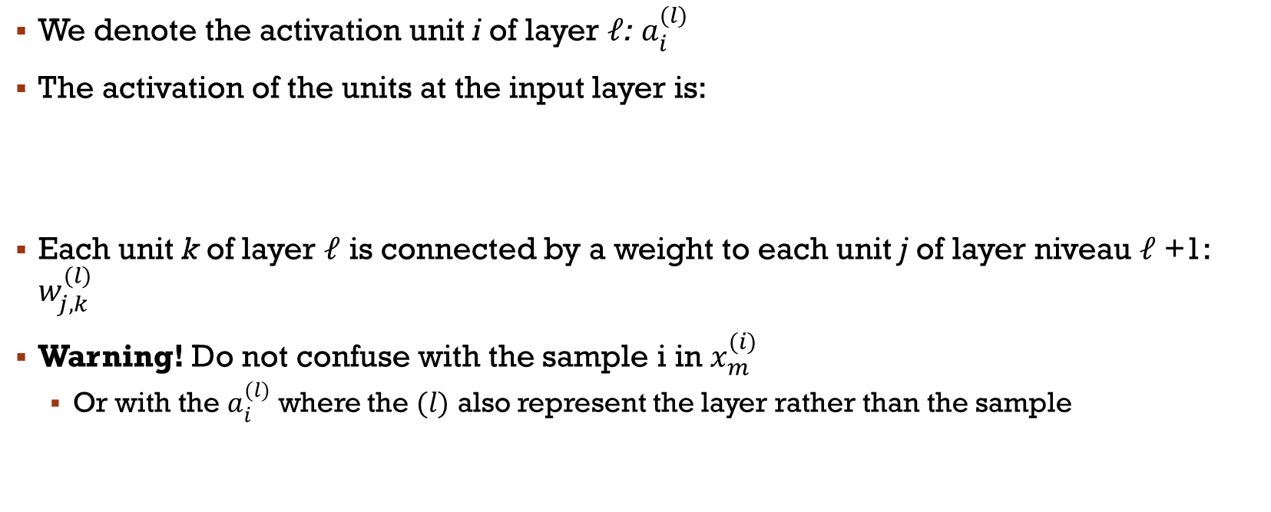
Multilayer Perceptron
We denote the activation unit i of layer $ℓ$: $a_{i}^{(l)}$
The activation of the units at the input layer is:
Each unit k of layer $ℓ$ is connected by a weight to each unit j of layer niveau $ℓ$+1: $w_{j,k}^{(l)}$
Warning! Do not confuse with the sample i in $x_{m}^{(i)}$
Or with the $a_{i}^{(l)}$ where the $(l)$ also represent the layer rather than the sample

Slide 17
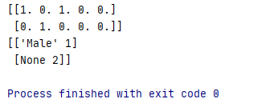
Natively Multiclasse?
One-hot
from sklearn.preprocessing import OneHotEncoder enc = OneHotEncoder(handle_unknown='ignore') X = [['Male', 1], ['Female', 3], ['Female', 2]] enc.fit(X) enc.categories_ print(enc.transform([['Female', 1], ['Male', 4]]).toarray()) print(enc.inverse_transform([[0, 1, 1, 0, 0], [0, 0, 0, 1, 0]])) enc.get_feature_names(['gender', 'group'])
[ 0 1 0 1 0 0 0 1 0]

Slide 18
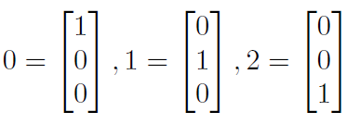
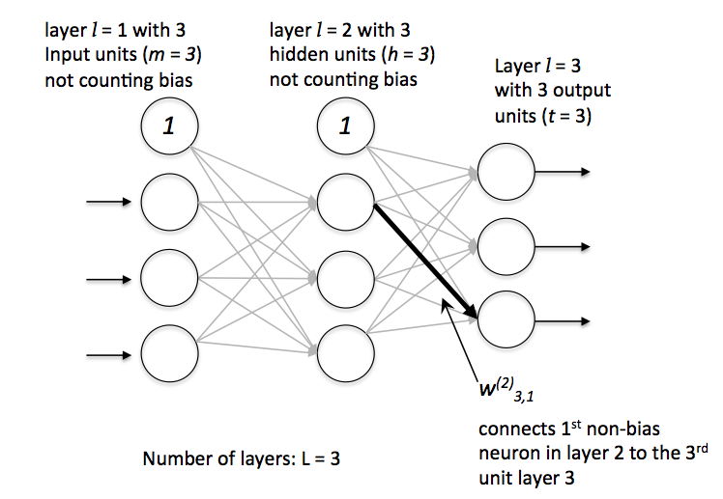
Perceptron Multicouche
A unit in the output layer allows for binary classification
Using the one-hot vector class representation, we can move to multiclass problems
Unlike integer class representation, one-hot encoding does not cause problems with algorithms based on distances
Notes:
Montrer au tableau pourquoi ça marche (y-ŷ)

Slide 19
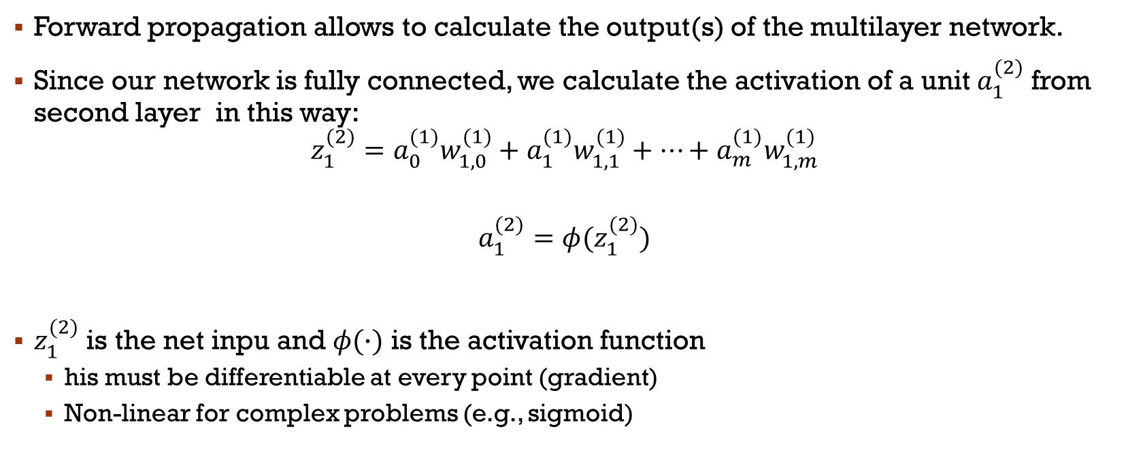

Forward propagation
Forward propagation allows to calculate the output(s) of the multilayer network.
Since our network is fully connected, we calculate the activation of a unit $a_{1}^{(2)}$ from second layer in this way:
$$z_{1}^{(2)}=a_{0}^{(1)}w_{1,0}^{(1)}+a_{1}^{(1)}w_{1,1}^{(1)}+…+a_{m}^{(1)}w_{1,m}^{(1)}$$
$$a_{1}^{(2)}=φ(z_{1}^{(2)})$$
$z_{1}^{(2)}$ is the net inpu and $φ(∙)$ is the activation function
his must be differentiable at every point (gradient)
Non-linear for complex problems (e.g., sigmoid)
$φ\left(z\right)=\frac{1}{1+e^{−z}}$
Notes:
Sigmoid de logistic regression

Slide 20
Forward propagation
Each layer serves as the input to the next layer without any loops
This is not the case in a recurrent neural network, where, on the contrary, there is a loop!
They aren’t the only model with loop, Echo State Networks, Attention Mechanisms/Transformers, Memory Network are other type of more advance neural net with loop (out of our scope)
Attention! Even though this model is called a multi-layer perceptron, the layers are composed of sigmoid units like logistic regression
For historical reasons, in deep learning, any neurons became called Perceptron
So, we think of it as perceptron with different activation even if it is equivalent to an Adaline or a Logistic Regression

Slide 21
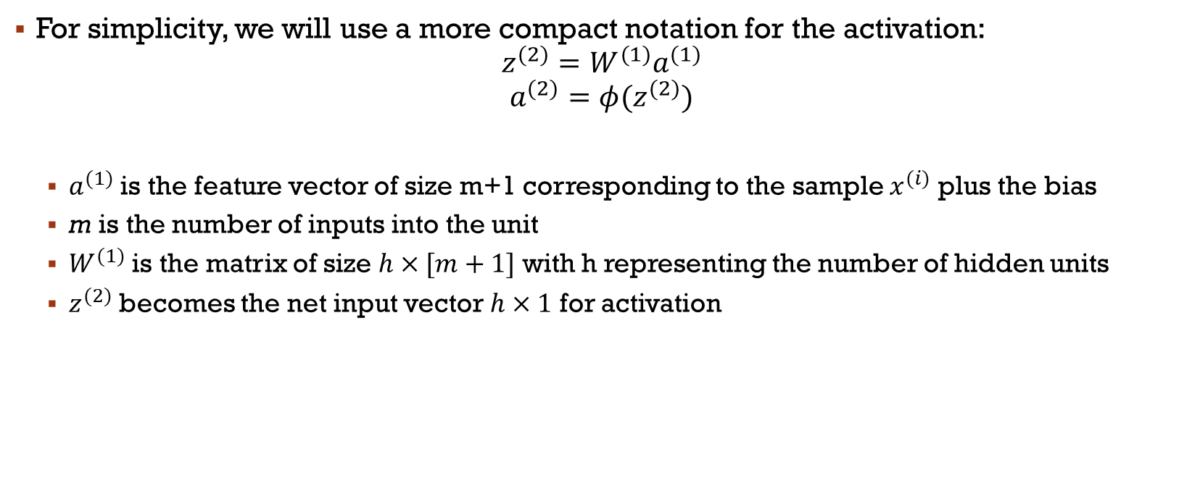
Forward propagation
For simplicity, we will use a more compact notation for the activation:
$$z^{(2)}=W^{(1)}a^{(1)}$$
$$a^{(2)}=φ(z^{(2)})$$
$a^{(1)}$ is the feature vector of size m+1 corresponding to the sample $x^{(i)}$ plus the bias
m is the number of inputs into the unit
$W^{(1)}$ is the matrix of size $h×[m+1]$ with h representing the number of hidden units
$z^{(2)}$ becomes the net input vector $h×1$ for activation
Notes:
Biais→ threshold d’activation

Slide 22
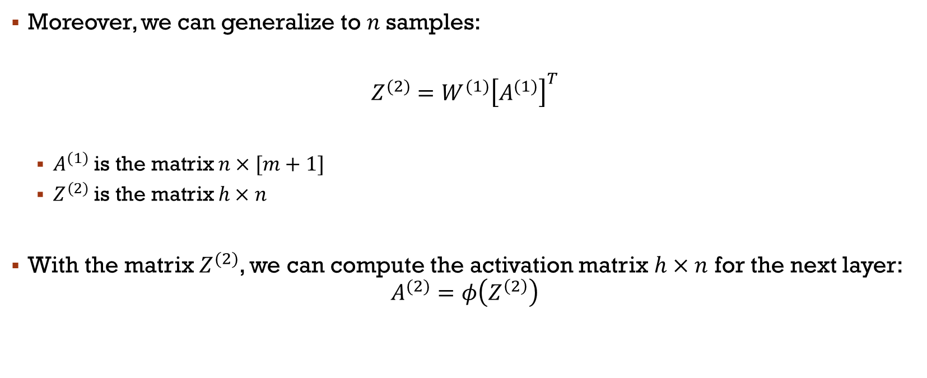
Propagation avant
Moreover, we can generalize to $n$samples:
$$Z^{(2)}=W^{(1)}{\left[A^{(1)}\right]}^{T}$$
$A^{(1)}$ is the matrix $n×[m+1]$
$Z^{(2)}$ is the matrix $h×n$
With the matrix $Z^{(2)}$, we can compute the activation matrix $h×n$ for the next layer:
$$A^{(2)}=φ\left(Z^{\left(2\right)}\right)$$
Notes:
Biais→ threshold d’activation
C’est idéal comme implémentation!

Slide 23
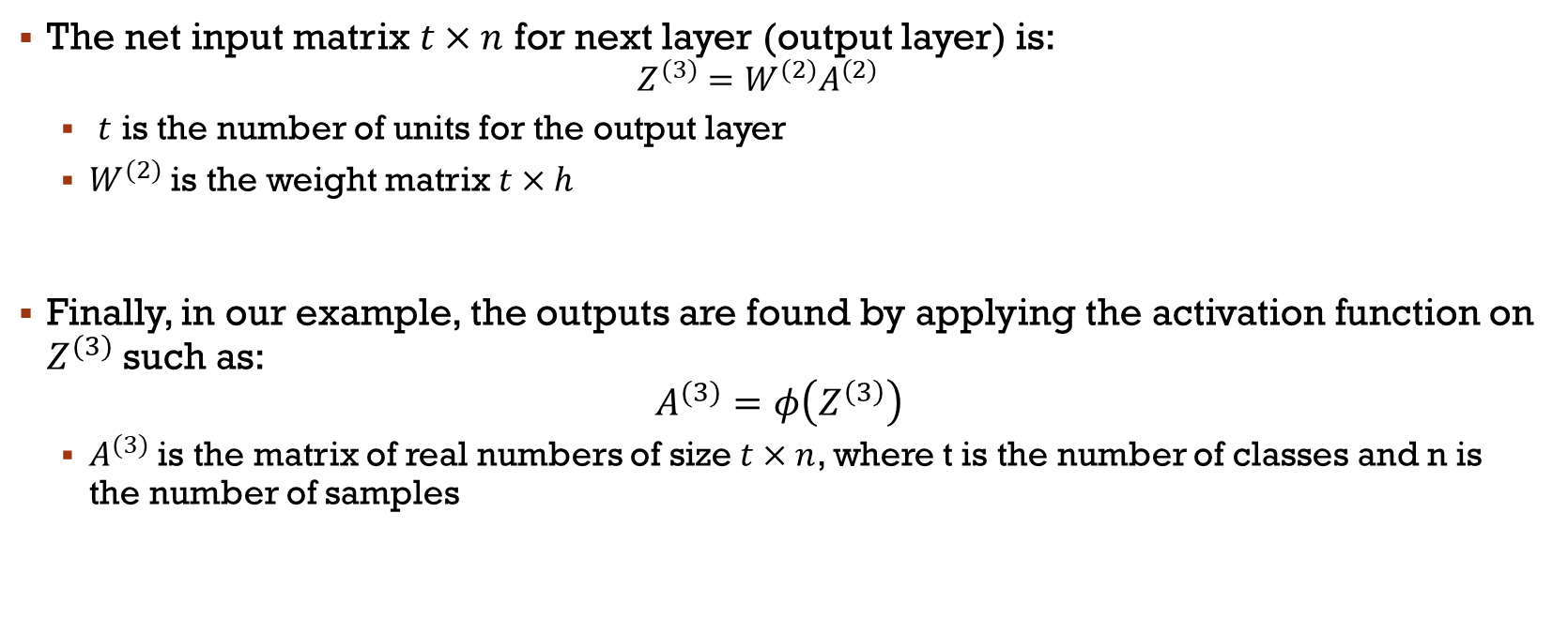
Propagation Avant
The net input matrix $t×n$ for next layer (output layer) is:
$$Z^{(3)}=W^{(2)}A^{(2)}$$
$t$ is the number of units for the output layer
$W^{(2)}$ is the weight matrix $t×h$
Finally, in our example, the outputs are found by applying the activation function on $Z^{(3)}$ such as:
$$A^{(3)}=φ\left(Z^{\left(3\right)}\right)$$
$A^{(3)}$ is the matrix of real numbers of size $t×n$, where t is the number of classes and n is the number of samples

Slide 24
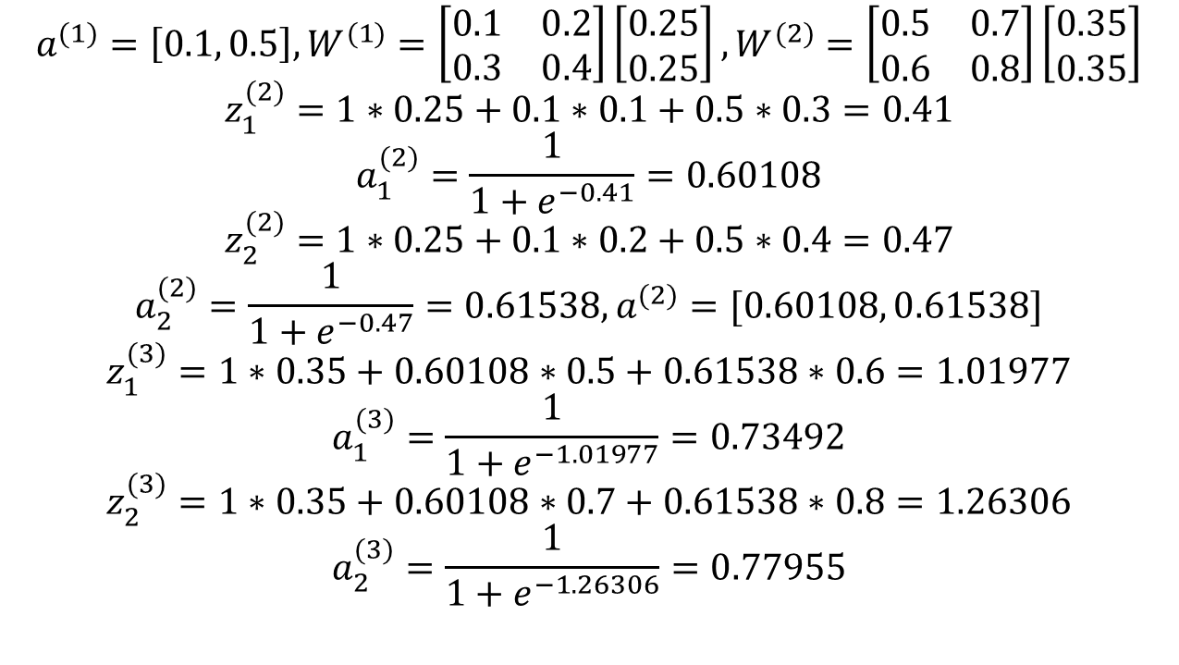
Forward propagation with numbers
biais
biais
$$a^{(1)}=\left[0.1, 0.5\right],W^{(1)}=\left[\begin{matrix}0.1 & 0.2 \\ 0.3 & 0.4\end{matrix}\right]\left[\begin{matrix}0.25 \\ 0.25\end{matrix}\right],W^{(2)}=\left[\begin{matrix}0.5 & 0.7 \\ 0.6 & 0.8\end{matrix}\right]\left[\begin{matrix}0.35 \\ 0.35\end{matrix}\right]$$
$$z_{1}^{(2)}=1∗0.25+0.1∗0.1+0.5∗0.3=0.41$$
$$a_{1}^{(2)}=\frac{1}{1+e^{−0.41}}=0.60108$$
$$z_{2}^{(2)}=1∗0.25+0.1∗0.2+0.5∗0.4=0.47$$
$$a_{2}^{(2)}=\frac{1}{1+e^{−0.47}}=0.61538, a^{(2)}=[0.60108, 0.61538]$$
$$z_{1}^{(3)}=1∗0.35+0.60108∗0.5+0.61538∗0.6=1.01977$$
$$a_{1}^{(3)}=\frac{1}{1+e^{−1.01977}}=0.73492$$
$$z_{2}^{(3)}=1∗0.35+0.60108∗0.7+0.61538∗0.8=1.26306$$
$$a_{2}^{(3)}=\frac{1}{1+e^{−1.26306}}=0.77955$$
Notes:
Ajouter schéma au tableau
Demander comment on prend la décision
https://theneuralblog.com/forward-pass-backpropagation-example/

Slide 25
Main References
Russell S., Norvig P., Artificial Intelligence: A Modern Approach. Prentice-Hall, Englewood Cliffs, 2021.
Aggarwal, C. C., Neural networks and deep learning. Springer, 2023.
Goodfellow I., Bengio Y., Deep Learning. The MIT Press, 2016.
Raschka S., Python Machine Learning, Packt Publishing, 2015.
Sutton R.S., Barto A.G., Reinforcement Learning: An Introduction, A Bradford Book, 2021.
Witten I.H., Frank E., Hall M.A., Pal C. Data Mining: Practical Machine Learning Tools and Techniques, Morgan Kaufmann, 2016.

